Slide 1
Water Level Management using IoT
A Smart Solution for Real-Time Monitoring and Automated Control

Slide 2
Problem Statement
Objectives
System Requirements
Functional Description System Architecture Benefits
Future Enhancement Conclusion
Agenda

Slide 3

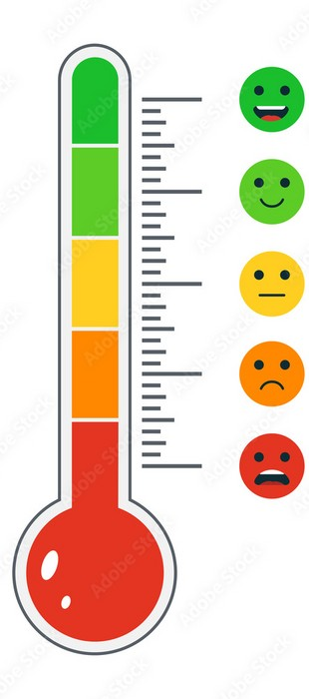
Problem Statement
Develop an IoT-based smart water management system to monitor and control water levels automatically and manually in real-time for both residential and industrial applications, enhancing efficiency and conservation.

Slide 4
OBJECTIVES
Enable real-time monitoring and control of water levels through IoT technology.
Automate water pump activation to maintain optimal water levels and prevent overflow.
Provide remote access and control via the Blynk app for user convenience.
Ensure water conservation by preventing both shortages and excessive water usage.

Slide 5
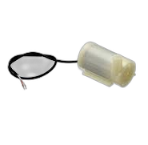
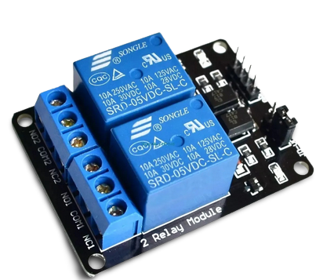
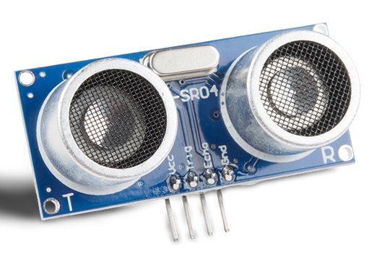
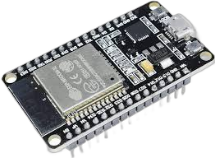
COMPONENTS USED
SENSOR
Ultrasonic Sensor
PROCESSOR
ESP 32
ACTUATORS
Motor
RELAY MODULE

Slide 6
Functional Description
SENSING
DATA TRANSMISSION
MODE SELECTION
RESPONSE
MONITORING

Slide 7
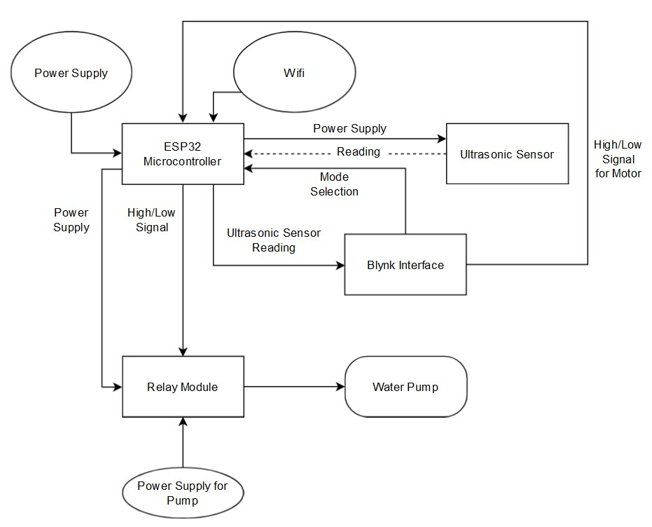
SYSTEM ARCHITECTURE

Slide 8
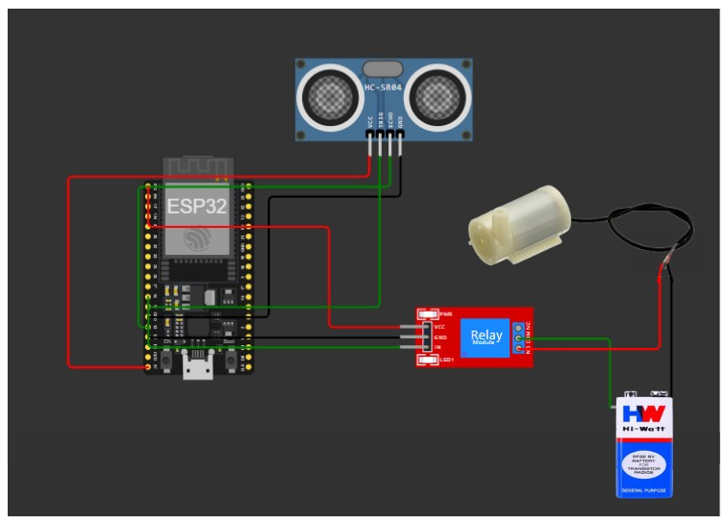
CIRCUIT DIAGRAM
Ultrasonic Sensor
Water Pump
Relay Module
ESP32
Microcontroller
Power Supply

Slide 9
- Sensor Fusion: More sensors, precise readings (pressure), water quality (conductivity).
Future Enhancements
- Scalability: Multiple sensors for vast areas (agriculture, water
networks).
AI/Machine Learning: Analyze usage, predict demand, optimize pump operation.
Smart Irrigation Integration: Automates watering based on real-time data and weather.
Advanced Security: Biometric sensors for secure access control.
Cloud Management: Real-time monitoring & insightful dashboards from anywhere.

Slide 10
BENEFITS
Real-time Monitoring & Automated Control: Eliminates manual checks and ensures timely action with automatic pump operation.
Water Conservation: Prevents overflows and optimizes usage through real-time data for informed decisions.
Simplified Management: Automates tasks and offers a user-friendly interface for easy control.
Data-Driven Decisions: Provides insights for identifying areas to improve water usage efficiency.
Scalable & Flexible: Adapts to manage large areas with both automatic and manual control options.

Slide 11
THANK YOU..!!

